Slide 1
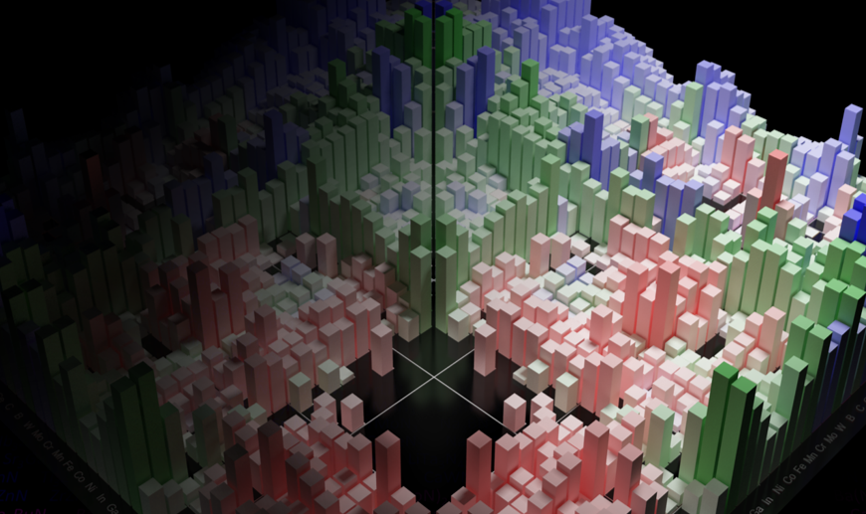
MSE 593 Data-Driven Materials Design and Genomics
If you are just joining us:
Please log into a computer with your UMID and your Password
Click on CAEN software on the Desktop.
On the software page, search for and install “Anaconda 2019.3 Python 3.7 MSE”
After installation, open start menu, go to Anaconda3 folder, then open Spyder
In a browser, go to
wenhaosun.github.io
click on MSE OpenHouse
Data-Driven
Materials Design
and Genomics
Wenhao Sun, Assistant Professor
whsun@umich.edu , H.H. Dow 2001

Slide 2
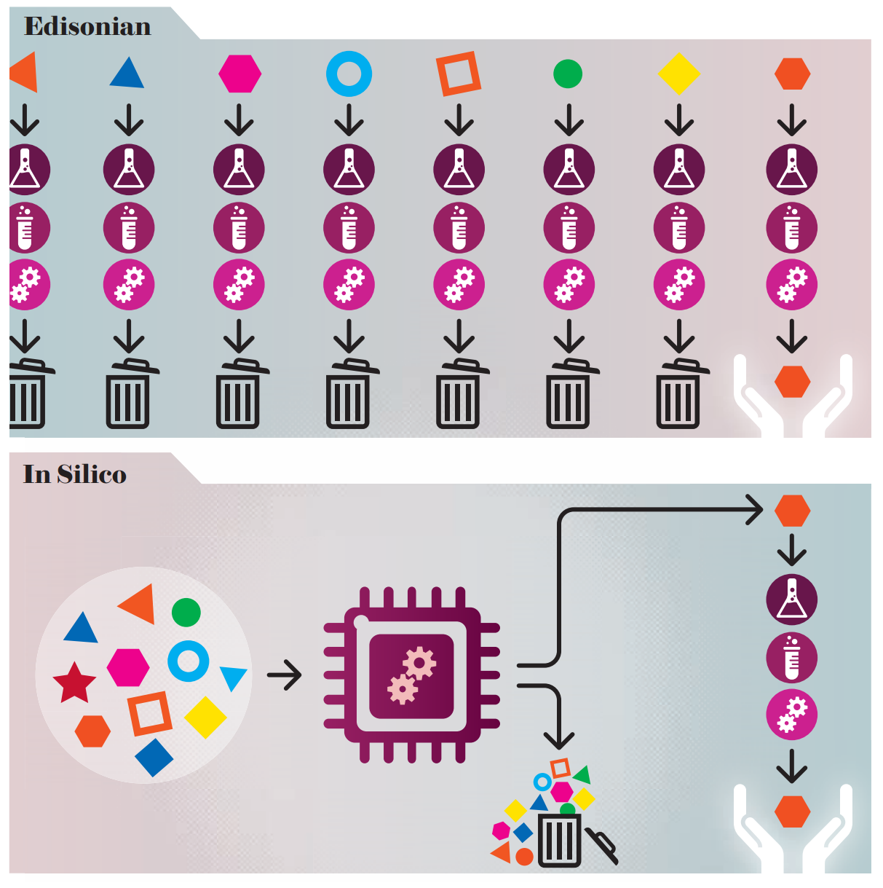
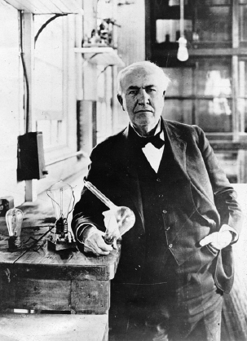
If you are just joining us:
Please log into a computer with your UMID and your Password
Click on CAEN software on the Desktop.
On the software page, search for and install “Anaconda 2019.3 Python 3.7 MSE”
After installation, open start menu, go to Anaconda3 folder, then open Spyder
In a browser, go to
wenhaosun.github.io
click on MSE OpenHouse
Thomas Edison (1879)
Inventor of Lightbulb
Experimental exploration of new materials
is expensive and laborious…
Ceder, Persson, Scientific American (2013)
Notes:
So, one route to Materials Design is known as the “Edisonian Route.” As you may remember, when Thomas Edison invented the lightbulb, he tried thousands of materials for the lightbulb filament, many of which did not work. It was only after three thousand materials that he found a working material, which was actually a carbon based material and isn’t even the Tungsten filament used for the last century.

Slide 3
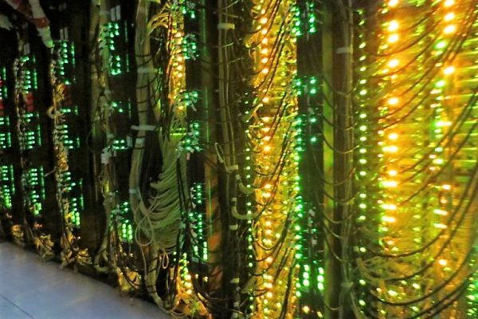
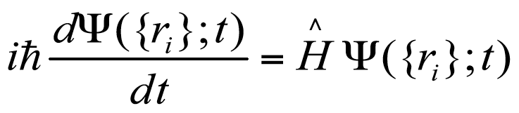
University of Michigan
GreatLakes
Supercomputering Cluster
If you are just joining us:
Please log into a computer with your UMID and your Password
Click on CAEN software on the Desktop.
On the software page, search for and install “Anaconda 2019.3 Python 3.7 MSE”
After installation, open start menu, go to Anaconda3 folder, then open Spyder
In a browser, go to
wenhaosun.github.io
click on MSE OpenHouse
Computation (DFT) can search and ‘pick out’ promising candidate materials!
Ceder, Persson, Scientific American (2013)

Slide 4

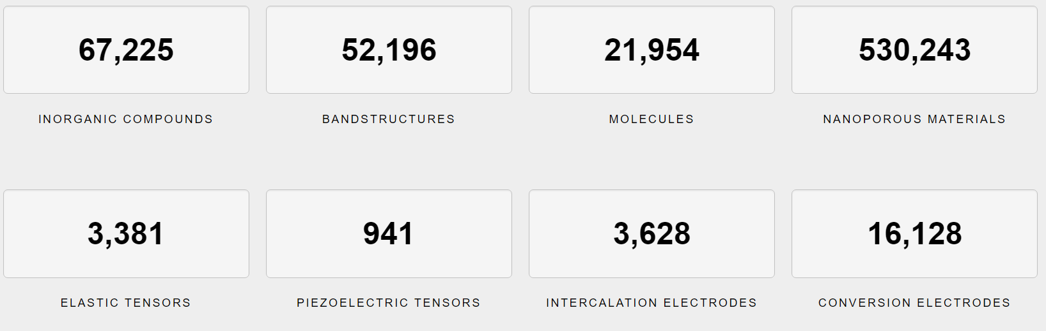
Accelerating Materials Discovery
via High-throughput Computation
If you are just joining us:
Please log into a computer with your UMID and your Password
Click on CAEN software on the Desktop.
On the software page, search for and install “Anaconda 2019.3 Python 3.7 MSE”
After installation, open start menu, go to Anaconda3 folder, then open Spyder
In a browser, go to
wenhaosun.github.io
click on MSE OpenHouse
The Materials Project Database
Notes:
accelerating materials discovery, via high-throughput computation. Density functional theory, which is the workhorse of computational materials science, is so computationally affordable now, that we can actually calculate the properties of nearly all known inorganic crystals, and compile our results into these enormous materials properties databases. The database that we built, the MaterialsProject, has nearly 70,000 entries, with computed band structures, elastic tensors, and we’re adding new properties every year.

Slide 5
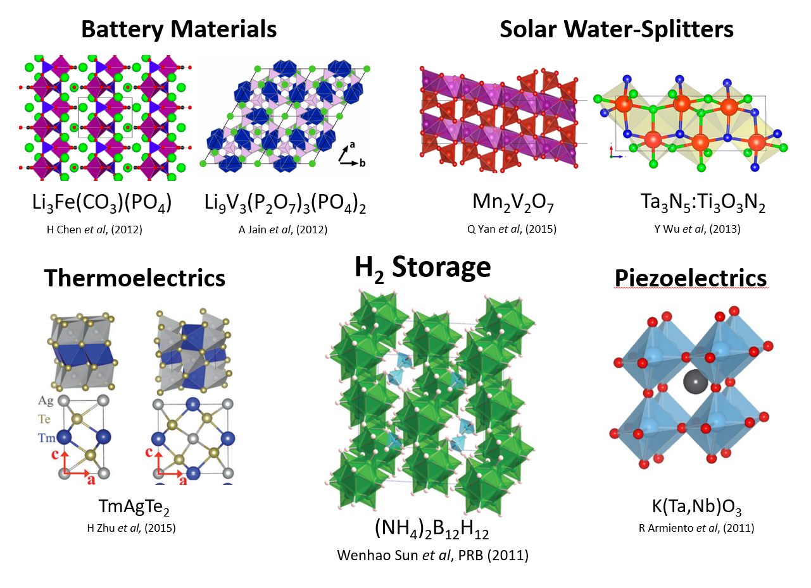
Accelerating Materials Discovery
via High-throughput Computation
If you are just joining us:
Please log into a computer with your UMID and your Password
Click on CAEN software on the Desktop.
On the software page, search for and install “Anaconda 2019.3 Python 3.7 MSE”
After installation, open start menu, go to Anaconda3 folder, then open Spyder
In a browser, go to
wenhaosun.github.io
click on MSE OpenHouse
The Materials Project Database
Screen for new:
- Battery Cathodes High Voltage, Capacity, and Diffusion
- Solar cells 1.2 eV Band Gap, Low Effective Mass, High Photon Absorption
- Thermoelectrics High Conductivity and Seebeck, Low thermal conductivity
- Photocatalysts Large Band Gap straddling H₂/H₂O and H₂O/O₂ potentials
Notes:
The idea is, that within these 70,000 materials and their derivatives, there are materials with properties that can make superior battery cathodes, solar cells, thermoelectrics, photocatalysts, you name it, we’ve probably searched for it.
And this strategy works, here is just a small collection of high-performance materials that we’ve predicted from high-throughput computation, including a hydrogen storage that I myself identified when I was an undergraduate, back when hydrogen storage was still a thing …

Slide 6

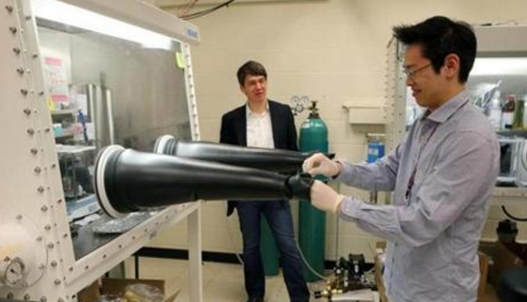
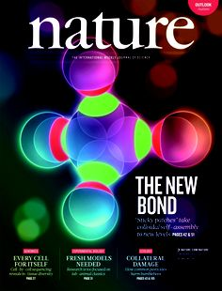

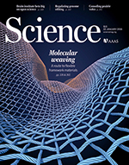
Accelerating Materials Discovery
via High-throughput Computation
If you are just joining us:
Please log into a computer with your UMID and your Password
Click on CAEN software on the Desktop.
On the software page, search for and install “Anaconda 2019.3 Python 3.7 MSE”
After installation, open start menu, go to Anaconda3 folder, then open Spyder
In a browser, go to
wenhaosun.github.io
click on MSE OpenHouse
The Materials Project Database
Screen for new:
- Battery Cathodes High Voltage, Capacity, and Diffusion
- Solar cells 1.2 eV Band Gap, Low Effective Mass, High Photon Absorption
- Thermoelectrics High Conductivity and Seebeck, Low thermal conductivity
- Photocatalysts Large Band Gap straddling H₂/H₂O and H₂O/O₂ potentials
Synthesize
novel materials
In the lab
Notes:
Anyway, now that we’ve predicted all these wonder materials, we take this list of predictions to our experimental colleagues, they go to the lab, they synthesize these materials, and we all become rich and famous.
At least, that’s the dream. Over the last five years or so, our group has come to a very sobering realization:

Slide 7
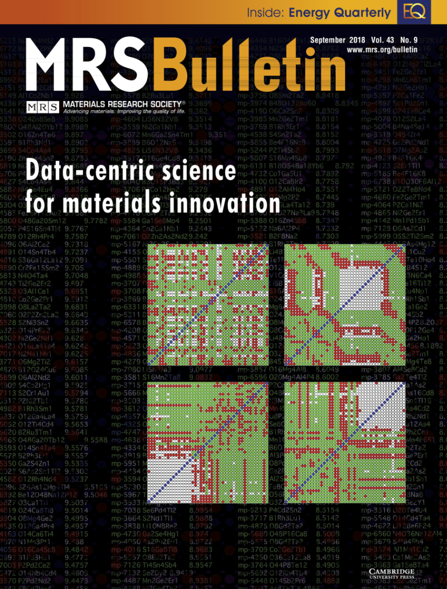
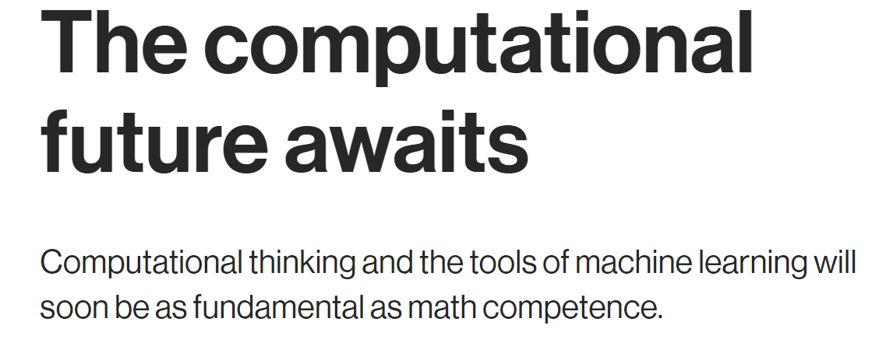
If you are just joining us:
Please log into a computer with your UMID and your Password
Click on CAEN software on the Desktop.
On the software page, search for and install “Anaconda 2019.3 Python 3.7 MSE”
After installation, open start menu, go to Anaconda3 folder, then open Spyder
In a browser, go to
wenhaosun.github.io
click on MSE OpenHouse
If you are just joining us:
Please log into a computer with your UMID and your Password
Click on CAEN software on the Desktop.
On the software page, search for and install “Anaconda 2019.3 Python 3.7 MSE”
After installation, open start menu, go to Anaconda3 folder, then open Spyder
- MIT Technology Review
“Machine-Learning is not
going to replace scientists …
But scientists who know
machine-learning are going to
replace scientists that do not
know machine-learning”

Slide 8
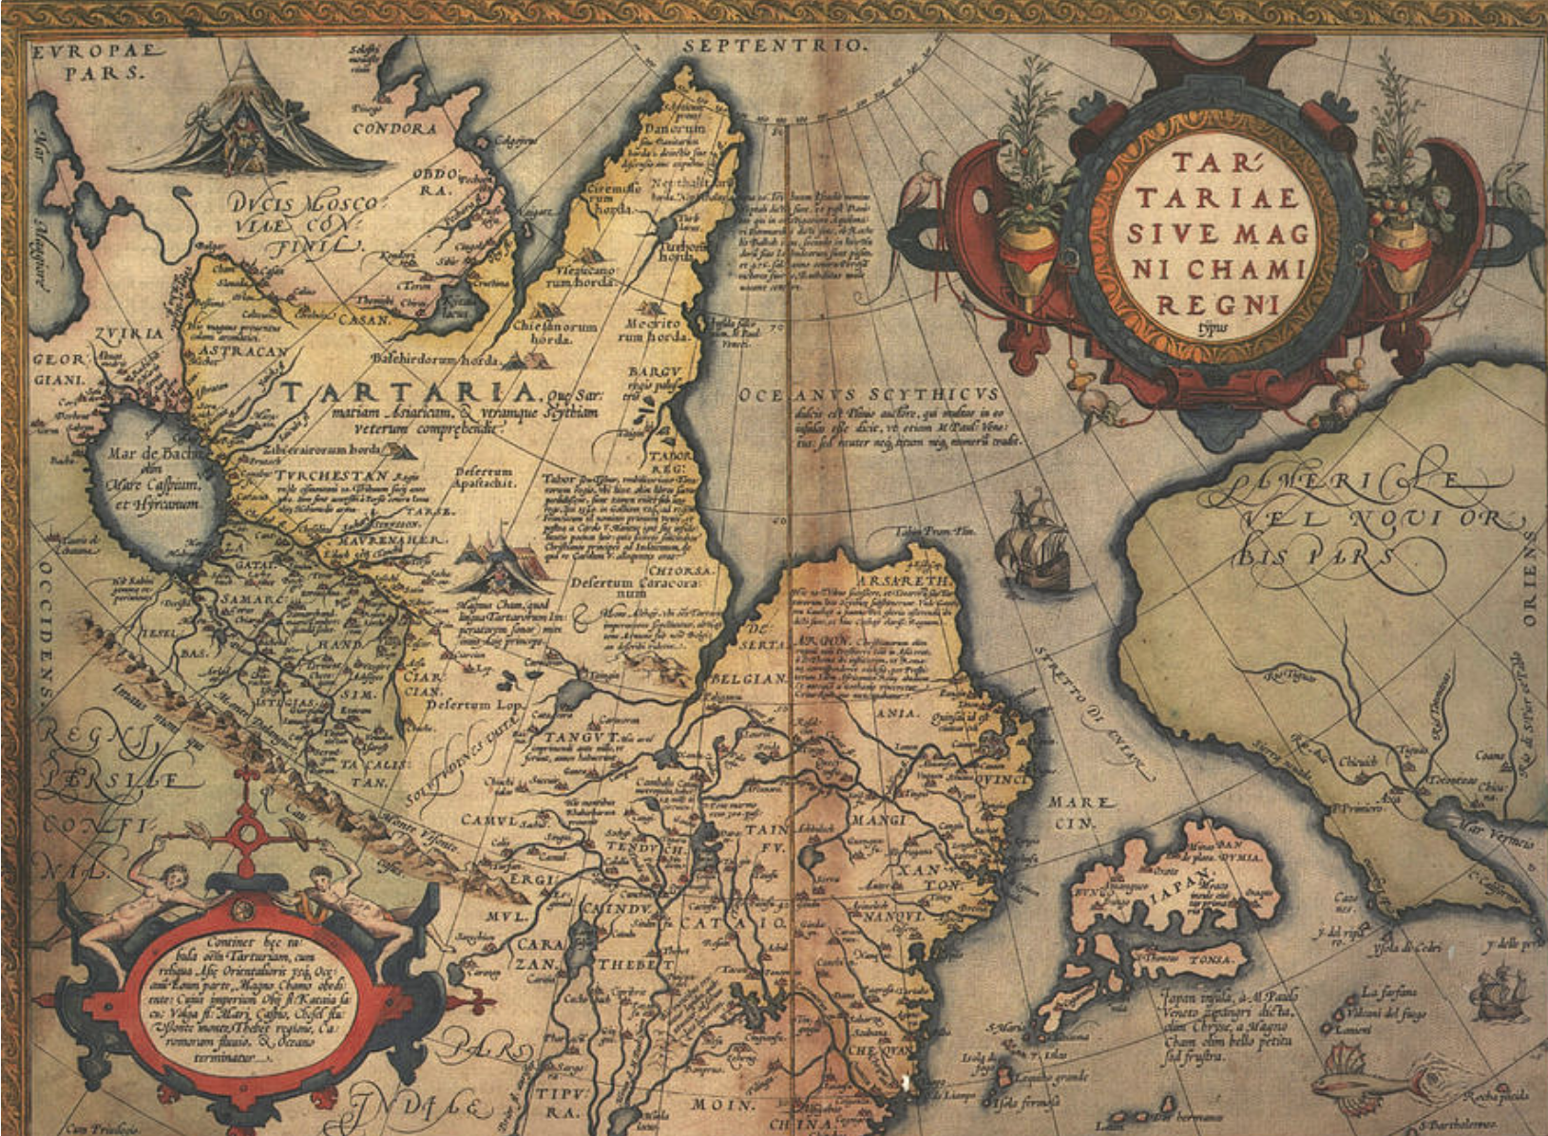
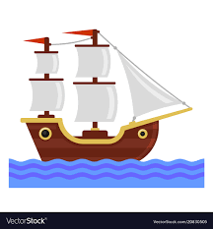
Exploratory Synthesis: Which new materials are synthesizable?
If you are just joining us:
Please log into a computer with your UMID and your Password
Click on CAEN software on the Desktop.
On the software page, search for and install “Anaconda 2019.3 Python 3.7 MSE”
After installation, open start menu, go to Anaconda3 folder, then open Spyder
In a browser, go to
wenhaosun.github.io
click on MSE OpenHouse
If you are just joining us:
Please log into a computer with your UMID and your Password
Click on CAEN software on the Desktop.
On the software page, search for and install “Anaconda 2019.3 Python 3.7 MSE”
After installation, open start menu, go to Anaconda3 folder, then open Spyder
Just as maps guided ancient explorers
in their discovery of the new world…

Slide 9
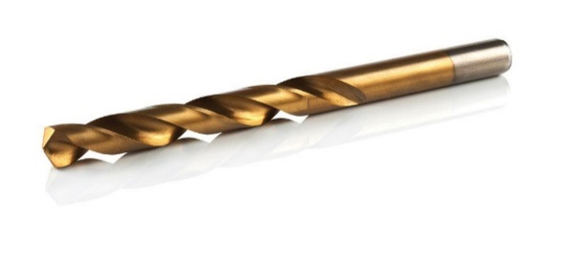
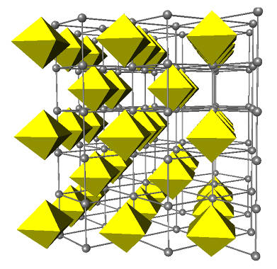

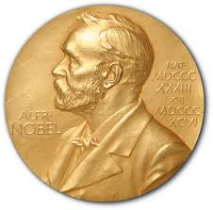
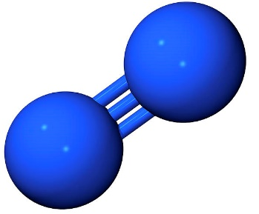
Exploratory Synthesis: Which new materials are synthesizable?
If you are just joining us:
Please log into a computer with your UMID and your Password
Click on CAEN software on the Desktop.
On the software page, search for and install “Anaconda 2019.3 Python 3.7 MSE”
After installation, open start menu, go to Anaconda3 folder, then open Spyder
In a browser, go to
wenhaosun.github.io
click on MSE OpenHouse
If you are just joining us:
Please log into a computer with your UMID and your Password
Click on CAEN software on the Desktop.
On the software page, search for and install “Anaconda 2019.3 Python 3.7 MSE”
After installation, open start menu, go to Anaconda3 folder, then open Spyder
Nitrides are important materials
TiN – Superhard Coatings
White Light LEDs
GaN → Nobel Prize
in Physics 2014
Fe₁₆N₂ – 4x stronger than neodymium
magnets
Nitrides are rare, because to make them
you need to break N₂ triple-bond.

Slide 10
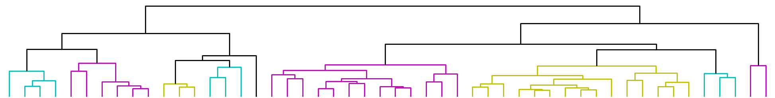
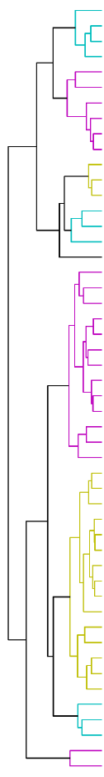
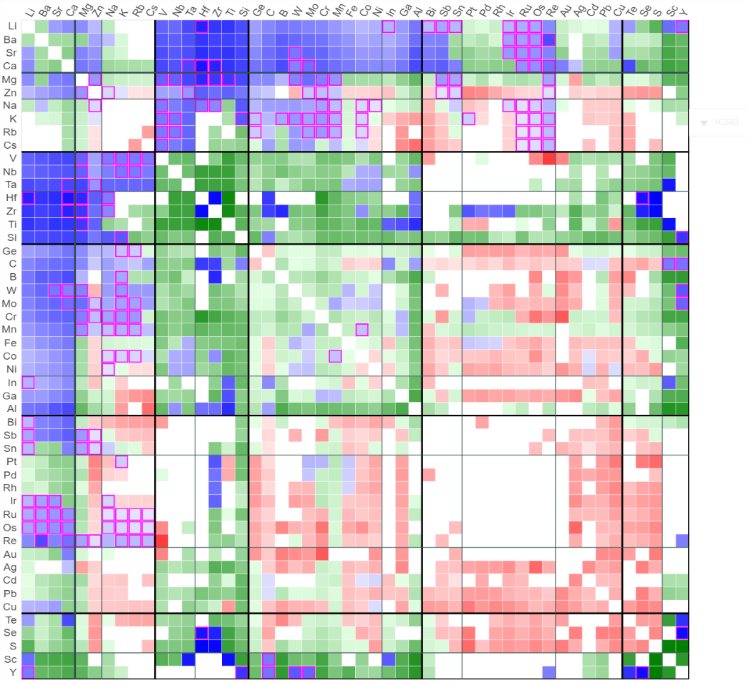
Exploratory Synthesis: Which new materials are synthesizable?
If you are just joining us:
Please log into a computer with your UMID and your Password
Click on CAEN software on the Desktop.
On the software page, search for and install “Anaconda 2019.3 Python 3.7 MSE”
After installation, open start menu, go to Anaconda3 folder, then open Spyder
In a browser, go to
wenhaosun.github.io
click on MSE OpenHouse
If you are just joining us:
Please log into a computer with your UMID and your Password
Click on CAEN software on the Desktop.
On the software page, search for and install “Anaconda 2019.3 Python 3.7 MSE”
After installation, open start menu, go to Anaconda3 folder, then open Spyder
Nitrides are important materials
A Map of the Inorganic Ternary Metal Nitrides
W. Sun et al., Nature Materials (2019)
TiN – Superhard Coatings
White Light LEDs
GaN → Nobel Prize
in Physics 2014
Fe₁₆N₂ – 4x stronger than neodymium
magnets
Nitrides are rare, because to make them
you need to break N₂ triple-bond.
Stable
Metastable
New Stable
Unstable

Slide 11
What does it mean for a material
to be stable?
If you are just joining us:
Please log into a computer with your UMID and your Password
Click on CAEN software on the Desktop.
On the software page, search for and install “Anaconda 2019.3 Python 3.7 MSE”
After installation, open start menu, go to Anaconda3 folder, then open Spyder
In a browser, go to
wenhaosun.github.io
click on MSE OpenHouse
If you are just joining us:
Please log into a computer with your UMID and your Password
Click on CAEN software on the Desktop.
On the software page, search for and install “Anaconda 2019.3 Python 3.7 MSE”
After installation, open start menu, go to Anaconda3 folder, then open Spyder
Suppose I have Elements: A and B,
and Compounds: A₂B, AB, AB₂, A₃B₂
Convex Hull
A + B → AB
2A + B → A₂B
A₂B + B → AB
AB + B → AB₂
AB₂ + A → AB
3A + 2B → A₃B₂
…
…
…
_{Etc!}
A
A₂B
AB
AB₂
B
Energy
A₃B₂
Metastable
Stable
Notes:
Anyway, now that we’ve predicted all these wonder materials, we take this list of predictions to our experimental colleagues, they go to the lab, they synthesize these materials, and we all become rich and famous.
At least, that’s the dream. Over the last five years or so, our group has come to a very sobering realization:

Slide 12
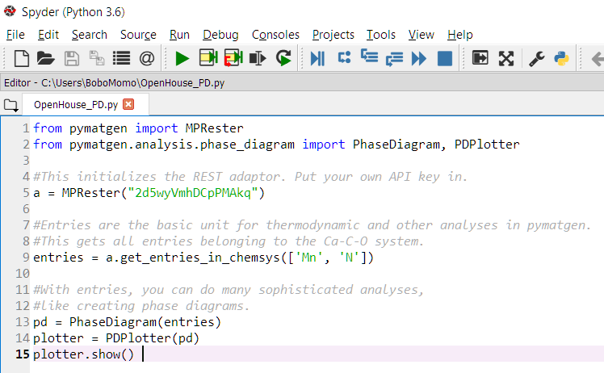
What does it mean for a material
to be stable?
If you are just joining us:
Please log into a computer with your UMID and your Password
Click on CAEN software on the Desktop.
On the software page, search for and install “Anaconda 2019.3 Python 3.7 MSE”
After installation, open start menu, go to Anaconda3 folder, then open Spyder
In a browser, go to
wenhaosun.github.io
click on MSE OpenHouse
If you are just joining us:
Please log into a computer with your UMID and your Password
Click on CAEN software on the Desktop.
On the software page, search for and install “Anaconda 2019.3 Python 3.7 MSE”
After installation, open start menu, go to Anaconda3 folder, then open Spyder
In a browser, open up wenhaosun.github.io/MSEopenhouse.html
Copy the first code into Spyder, and press the green ‘Run’ button at the top.
Notes:
Anyway, now that we’ve predicted all these wonder materials, we take this list of predictions to our experimental colleagues, they go to the lab, they synthesize these materials, and we all become rich and famous.
At least, that’s the dream. Over the last five years or so, our group has come to a very sobering realization:

Slide 13
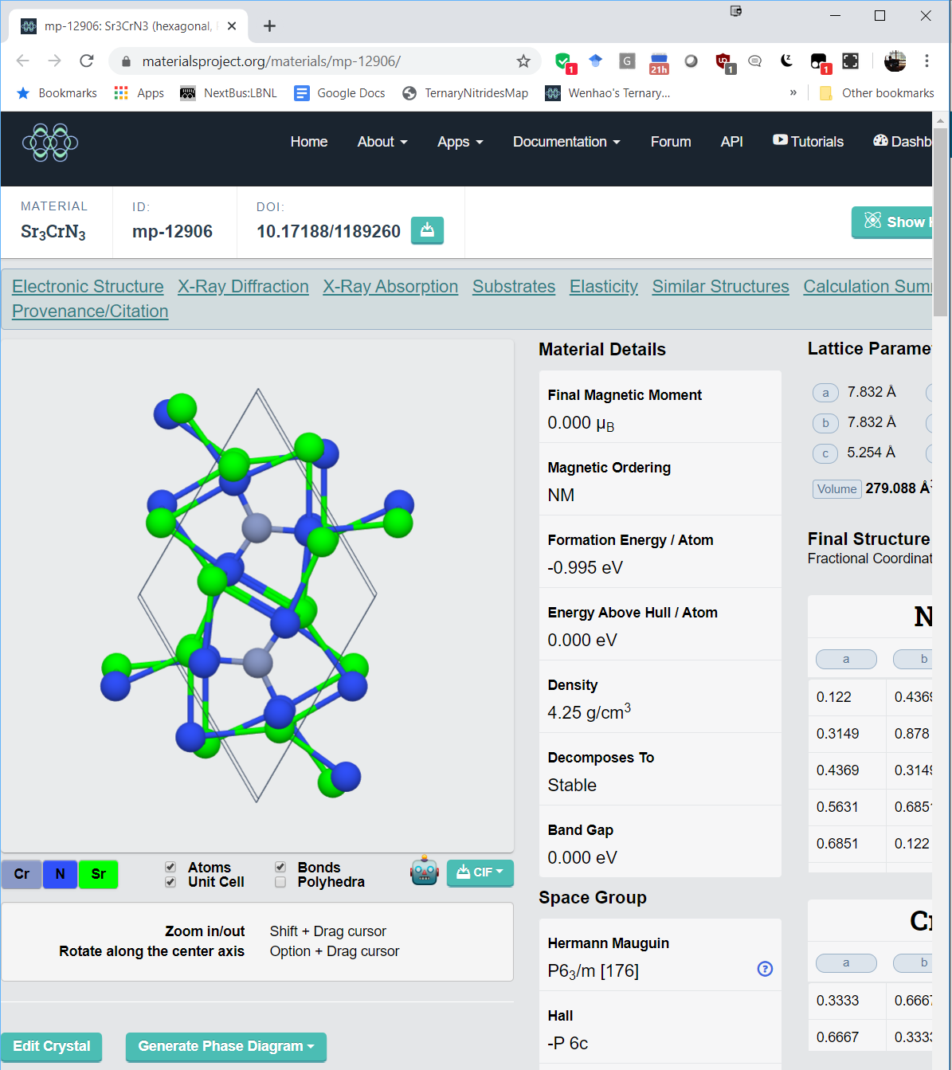
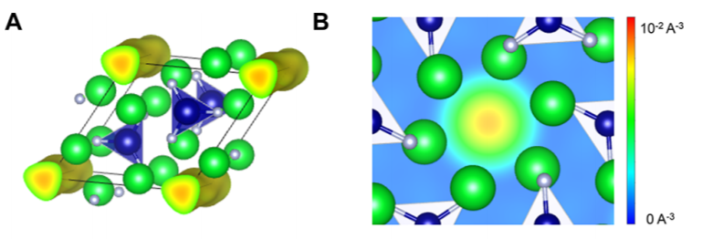
How can we make ‘new materials’
in a computer?
If you are just joining us:
Please log into a computer with your UMID and your Password
Click on CAEN software on the Desktop.
On the software page, search for and install “Anaconda 2019.3 Python 3.7 MSE”
After installation, open start menu, go to Anaconda3 folder, then open Spyder
In a browser, go to
wenhaosun.github.io
click on MSE OpenHouse
If you are just joining us:
Please log into a computer with your UMID and your Password
Click on CAEN software on the Desktop.
On the software page, search for and install “Anaconda 2019.3 Python 3.7 MSE”
After installation, open start menu, go to Anaconda3 folder, then open Spyder
Sr₃CrN₃ is an electride material
With an empty floating electron!
Sr₃Cr⁴⁺N₃:e⁻
Can we find another electride material?
Notes:
Anyway, now that we’ve predicted all these wonder materials, we take this list of predictions to our experimental colleagues, they go to the lab, they synthesize these materials, and we all become rich and famous.
At least, that’s the dream. Over the last five years or so, our group has come to a very sobering realization:

Slide 14
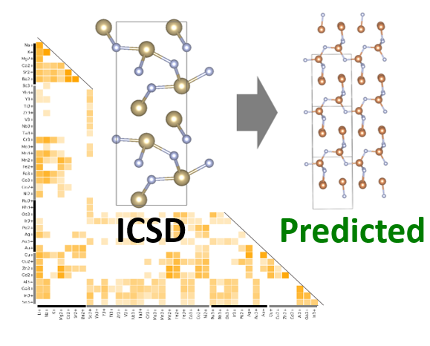
Computational Discovery of Novel Ternary Nitrides
If you are just joining us:
Please log into a computer with your UMID and your Password
Click on CAEN software on the Desktop.
On the software page, search for and install “Anaconda 2019.3 Python 3.7 MSE”
After installation, open start menu, go to Anaconda3 folder, then open Spyder
In a browser, go to
wenhaosun.github.io
click on MSE OpenHouse
If you are just joining us:
Please log into a computer with your UMID and your Password
Click on CAEN software on the Desktop.
On the software page, search for and install “Anaconda 2019.3 Python 3.7 MSE”
After installation, open start menu, go to Anaconda3 folder, then open Spyder
Convex Hull
A
A₂B
AB
AB₂
B
Formation Energy
Metastable
Stable
W. Sun et al., Chemistry of Materials (2017)
1. Data-mined
Structure Prediction
2. Evaluate stability
using DFT convex hull
6000 candidate nitrides made, ionic substitution from known Pnictides
We find 244 new
stable ternary nitrides
Notes:
Inspired by the ability to synthesize highly metastable nitrides, we set out to computationally identify new nitrides using a data-mining approach. Our methodology is based on the observation that within a class of materials, such as the Nitrides, materials with ‘similar’ elements share the same crystal structures. How do we determine which materials are similar? Well, we start from known materials, training the data-mining algorithm to see which cations are statistically prone to substitute for one another. Using this, we generate a substitution-probability matrix, determining which cations are likely to substitute for another in the same structure. We validate our matrix by using it to ‘predict’ known nitrides, by taking out a known nitride, and seeing if our algorithm can recover it. We find that it can do so over 80% of the time, and if we can identify known nitrides, well, feasibly we could use the same approach to identify unknown nitrides. So, using this substitution matrix on known nitrides, our data-mining algorithm has suggested 492 new binary nitrides, based on known structures. We next calculate their thermodynamics, to determine which ones are experimentally accessible.

Slide 15
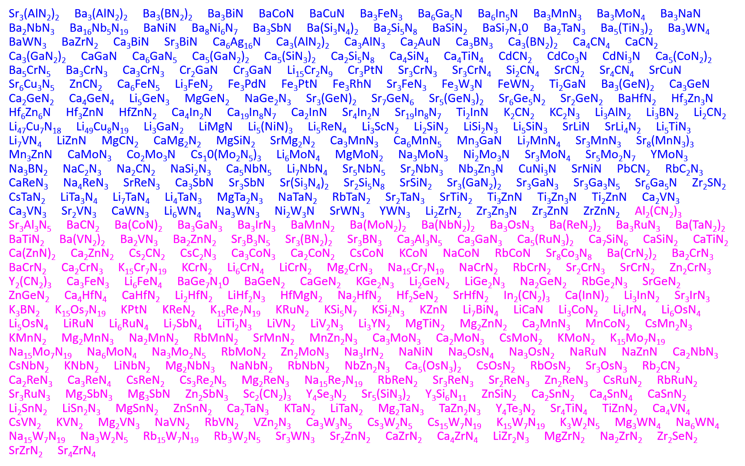
447 Stable Ternary Nitrides: 213 known, 244 new
If you are just joining us:
Please log into a computer with your UMID and your Password
Click on CAEN software on the Desktop.
On the software page, search for and install “Anaconda 2019.3 Python 3.7 MSE”
After installation, open start menu, go to Anaconda3 folder, then open Spyder
In a browser, go to
wenhaosun.github.io
click on MSE OpenHouse
If you are just joining us:
Please log into a computer with your UMID and your Password
Click on CAEN software on the Desktop.
On the software page, search for and install “Anaconda 2019.3 Python 3.7 MSE”
After installation, open start menu, go to Anaconda3 folder, then open Spyder
How can we elucidate the chemical families in this ternary nitride space?
W. Sun et al, Nature Materials (2019)
Notes:
Personally, I am often quite unsatisfied with the prediction of a large list of stable materials. While a large list of predictions can be very impressive, it is very difficult to process such a large dataset. Why do certain chemistries form stable compounds?

Slide 16
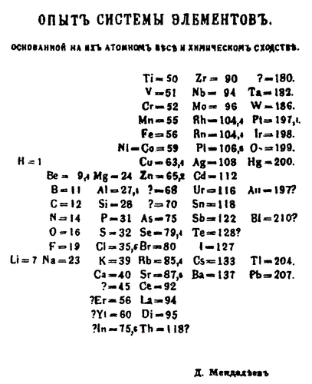
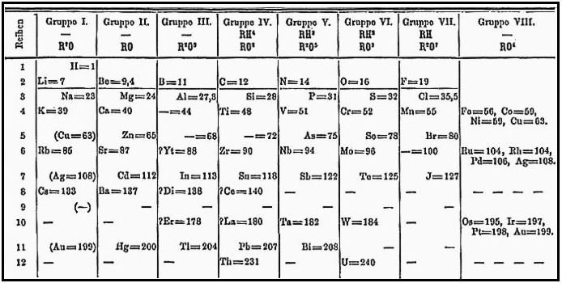
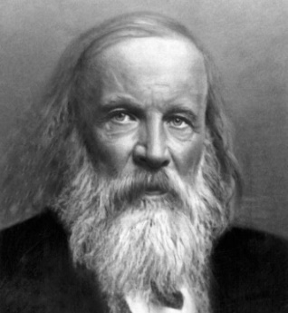
If you are just joining us:
Please log into a computer with your UMID and your Password
Click on CAEN software on the Desktop.
On the software page, search for and install “Anaconda 2019.3 Python 3.7 MSE”
After installation, open start menu, go to Anaconda3 folder, then open Spyder
In a browser, go to
wenhaosun.github.io
click on MSE OpenHouse
Mendeleev gave structural form to the Elements by constructing the Periodic Table
If you are just joining us:
Please log into a computer with your UMID and your Password
Click on CAEN software on the Desktop.
On the software page, search for and install “Anaconda 2019.3 Python 3.7 MSE”
After installation, open start menu, go to Anaconda3 folder, then open Spyder
Mendeleev
An effective visual organization can reveal hidden relationships and chemical families within the ternary metal nitrides
Notes:
This is the year of the Periodic Table, and you must remember that before Mendeleev, the elements also comprised an unstructured list. It was only by the genius of Mendeleev that he constructed the periodic principle.

Slide 17
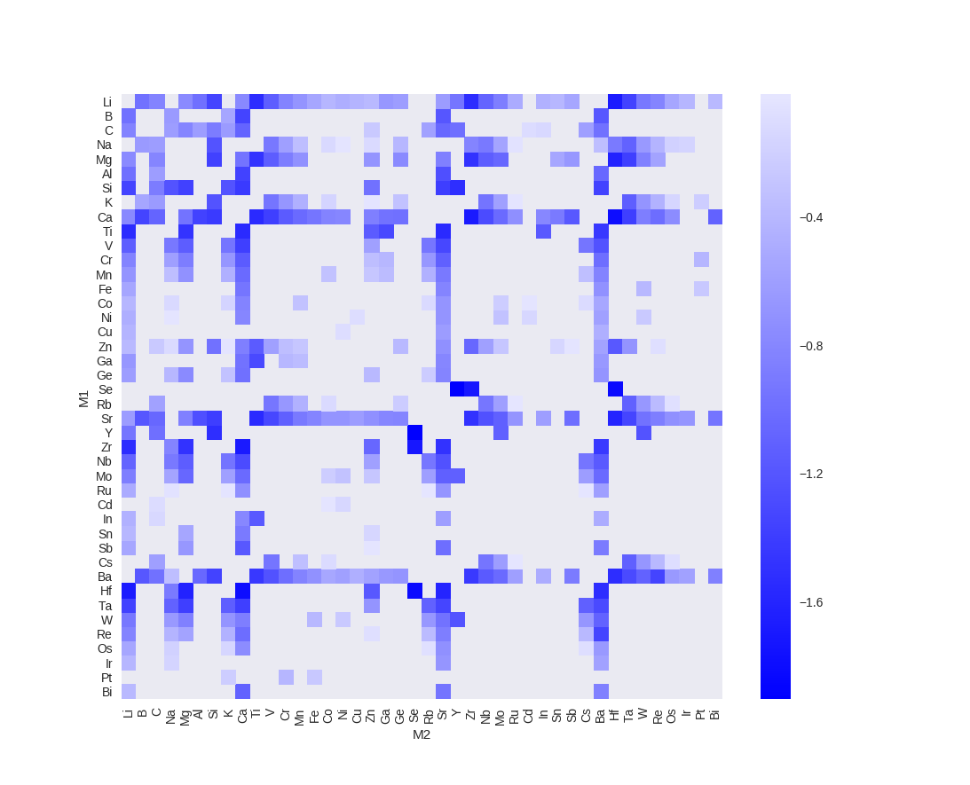
Formation Energies of M₁-M₂-Nitrides
(Axes ordered by atomic number)
If you are just joining us:
Please log into a computer with your UMID and your Password
Click on CAEN software on the Desktop.
On the software page, search for and install “Anaconda 2019.3 Python 3.7 MSE”
After installation, open start menu, go to Anaconda3 folder, then open Spyder
In a browser, go to
wenhaosun.github.io
click on MSE OpenHouse
If you are just joining us:
Please log into a computer with your UMID and your Password
Click on CAEN software on the Desktop.
On the software page, search for and install “Anaconda 2019.3 Python 3.7 MSE”
After installation, open start menu, go to Anaconda3 folder, then open Spyder
Formation energy of ‘deepest’ compound in ternary convex hull.
(Figure is symmetric across diagonal)

Slide 18

Hierarchical Clustering of Ternary Nitrides
If you are just joining us:
Please log into a computer with your UMID and your Password
Click on CAEN software on the Desktop.
On the software page, search for and install “Anaconda 2019.3 Python 3.7 MSE”
After installation, open start menu, go to Anaconda3 folder, then open Spyder
In a browser, go to
wenhaosun.github.io
click on MSE OpenHouse
If you are just joining us:
Please log into a computer with your UMID and your Password
Click on CAEN software on the Desktop.
On the software page, search for and install “Anaconda 2019.3 Python 3.7 MSE”
After installation, open start menu, go to Anaconda3 folder, then open Spyder
Unsupervised Machine Learning technique to elucidate chemical families in the ternary metal nitrides
Step 1
Step 2
Step 3
1. Construct a ‘distance matrix’ for propensity to form stable or metastable nitrides
2. Cluster nitrides by Stability, Metastability ΔH_{f} < 0, Metastability ΔH_{f} > 0
3. Build dendrogram of nitride chemical families

Slide 19
Hierarchical Clustering of Ternary Nitrides
If you are just joining us:
Please log into a computer with your UMID and your Password
Click on CAEN software on the Desktop.
On the software page, search for and install “Anaconda 2019.3 Python 3.7 MSE”
After installation, open start menu, go to Anaconda3 folder, then open Spyder
In a browser, go to
wenhaosun.github.io
click on MSE OpenHouse
If you are just joining us:
Please log into a computer with your UMID and your Password
Click on CAEN software on the Desktop.
On the software page, search for and install “Anaconda 2019.3 Python 3.7 MSE”
After installation, open start menu, go to Anaconda3 folder, then open Spyder
Unsupervised Machine Learning technique to elucidate chemical families in the ternary metal nitrides
Step 1
Step 2
Step 3
1. Construct a ‘distance matrix’ for propensity to form stable or metastable nitrides
2. Cluster nitrides by Stability, Metastability ΔH_{f} < 0, Metastability ΔH_{f} > 0
3. Build dendrogram of nitride chemical families

Slide 20
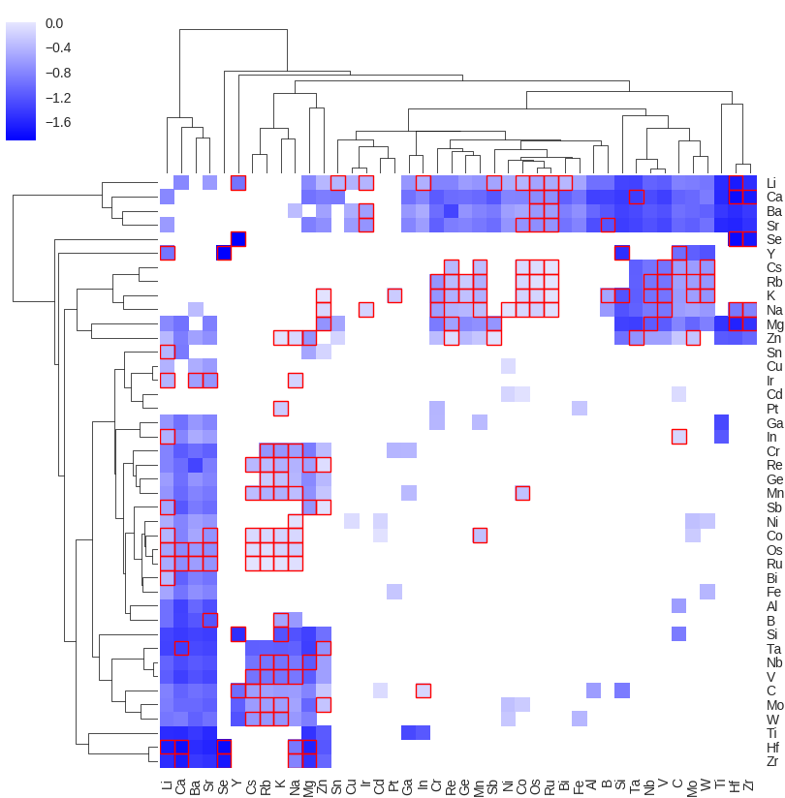
Hierarchical Clustering of Ternary Nitrides
If you are just joining us:
Please log into a computer with your UMID and your Password
Click on CAEN software on the Desktop.
On the software page, search for and install “Anaconda 2019.3 Python 3.7 MSE”
After installation, open start menu, go to Anaconda3 folder, then open Spyder
In a browser, go to
wenhaosun.github.io
click on MSE OpenHouse
Formation Energy
(eV/atom)
If you are just joining us:
Please log into a computer with your UMID and your Password
Click on CAEN software on the Desktop.
On the software page, search for and install “Anaconda 2019.3 Python 3.7 MSE”
After installation, open start menu, go to Anaconda3 folder, then open Spyder
Formation energy of ‘deepest’ compound in ternary convex hull.
(Figure is symmetric across diagonal)
Clusters metals together that have similar propensity for forming a stable ternary nitride
Rows and columns are clustered algorithmically
Box = New ternary nitride space

Slide 21

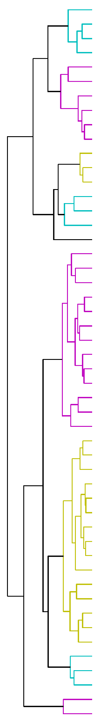

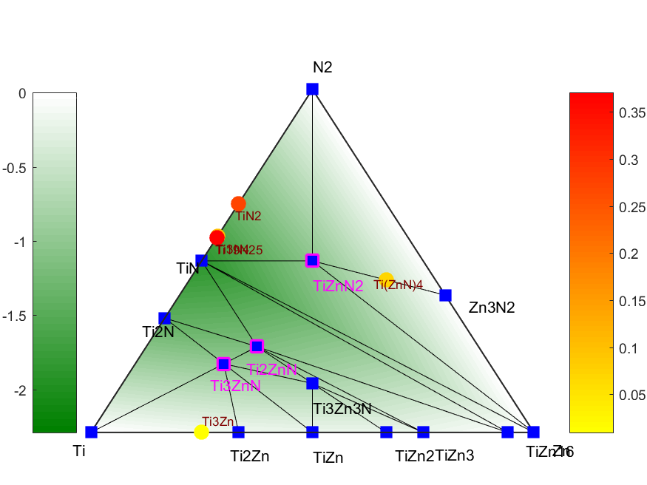
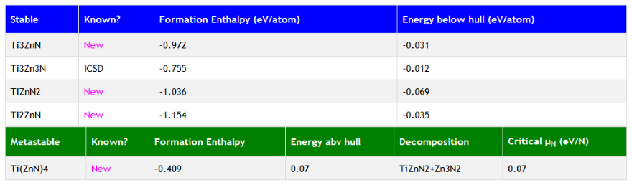
A Map of the Inorganic Ternary Metal Nitrides
If you are just joining us:
Please log into a computer with your UMID and your Password
Click on CAEN software on the Desktop.
On the software page, search for and install “Anaconda 2019.3 Python 3.7 MSE”
After installation, open start menu, go to Anaconda3 folder, then open Spyder
In a browser, go to
wenhaosun.github.io
click on MSE OpenHouse
If you are just joining us:
Please log into a computer with your UMID and your Password
Click on CAEN software on the Desktop.
On the software page, search for and install “Anaconda 2019.3 Python 3.7 MSE”
After installation, open start menu, go to Anaconda3 folder, then open Spyder
Blue (281)
Stable Ternary Nitride
Magenta (92)
New Stable Ternary
Green (420)
Metastable ternary
where ΔH_{f} < 0
Red (261)
Metastable ternary
where ΔH_{f} > 0
White
No likely substitution
Grayscale
“Depth” of ternary hull
Interactive @ wenhaosun.github.io/TernaryNitridesMap.html
W. Sun et al, Nature Materials (2019)

Slide 22
A Map of the Inorganic Ternary Metal Nitrides
If you are just joining us:
Please log into a computer with your UMID and your Password
Click on CAEN software on the Desktop.
On the software page, search for and install “Anaconda 2019.3 Python 3.7 MSE”
After installation, open start menu, go to Anaconda3 folder, then open Spyder
In a browser, go to
wenhaosun.github.io
click on MSE OpenHouse
If you are just joining us:
Please log into a computer with your UMID and your Password
Click on CAEN software on the Desktop.
On the software page, search for and install “Anaconda 2019.3 Python 3.7 MSE”
After installation, open start menu, go to Anaconda3 folder, then open Spyder
Blue (281)
Stable Ternary Nitride
Magenta (92)
New Stable Ternary
Green (420)
Metastable ternary
where ΔH_{f} < 0
Red (261)
Metastable ternary
where ΔH_{f} > 0
White
No likely substitution
Grayscale
“Depth” of ternary hull
Interactive @ wenhaosun.github.io/TernaryNitridesMap.html
W. Sun et al, Nature Materials (2019)

